Slide 1
BANK MARKETING
Business Analytics Case Study
AnalystLab Africa Internship Program • Week 5
Using Python to identify customer segments and campaign factors associated with term-deposit subscriptions.

Slide 2
1. Business Problem
The bank invests resources in marketing campaigns, but customers do not respond equally.
Which customer characteristics are associated with higher subscription rates?
Which campaign/contact factors appear to influence customer response?
How can the bank focus its marketing resources on higher-potential segments?
Business objective
Use descriptive analytics to identify patterns that can support more targeted and efficient marketing decisions.

Slide 3
2. Dataset Overview
Bank Marketing Dataset
11,162
17
5,289
47.4%
customer records
variables
subscriptions
overall subscription rate
Target variable: deposit — whether the customer subscribed to a term deposit.
Key variables include age, job, education, marital status, contact method, campaign month, previous outcome and call duration.
No missing values were detected and no duplicate records were found in the supplied dataset.

Slide 4
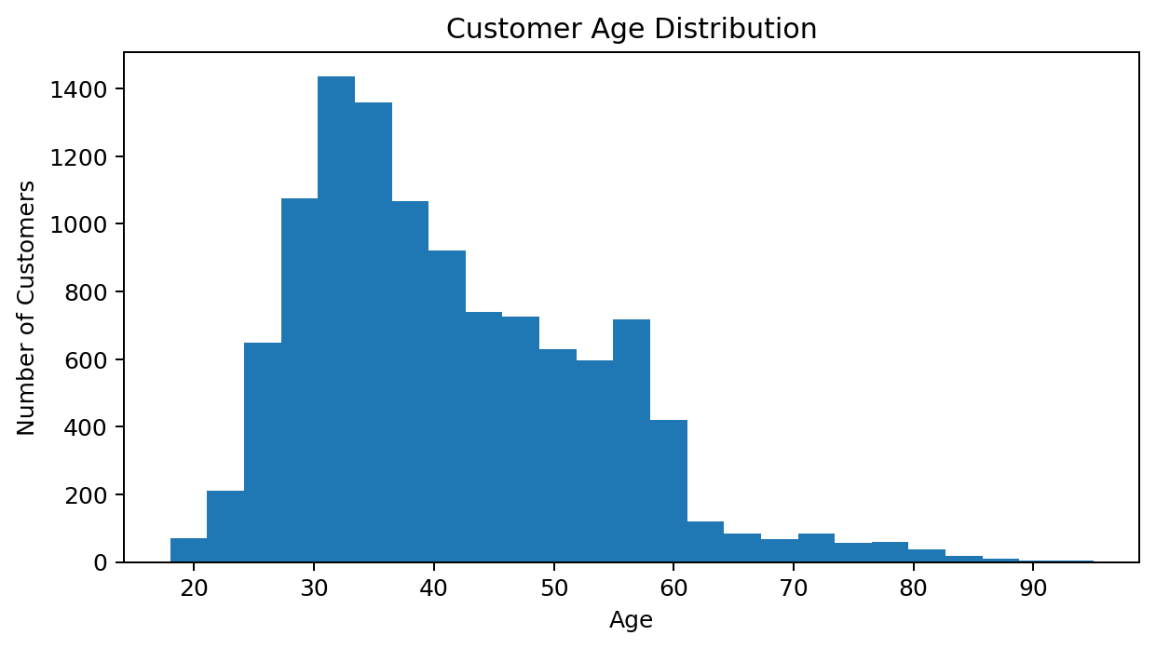
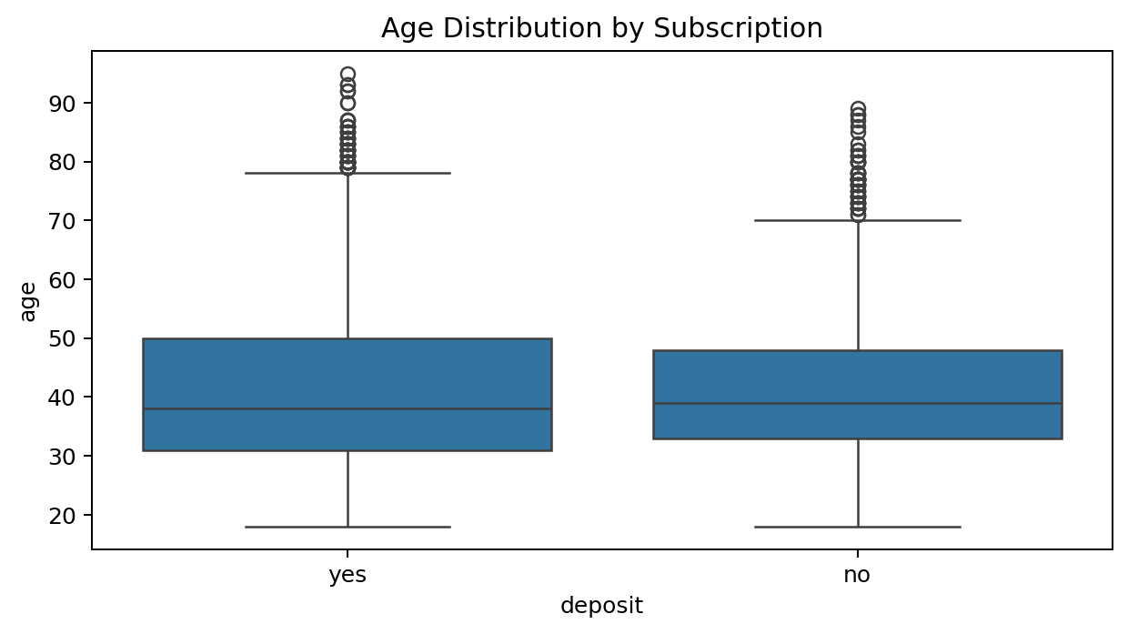
3. Customer Profile
Age distribution and subscription patterns
Insight: Subscribers and non-subscribers have broadly similar age distributions. Age alone does not appear to be a strong differentiator.

Slide 5
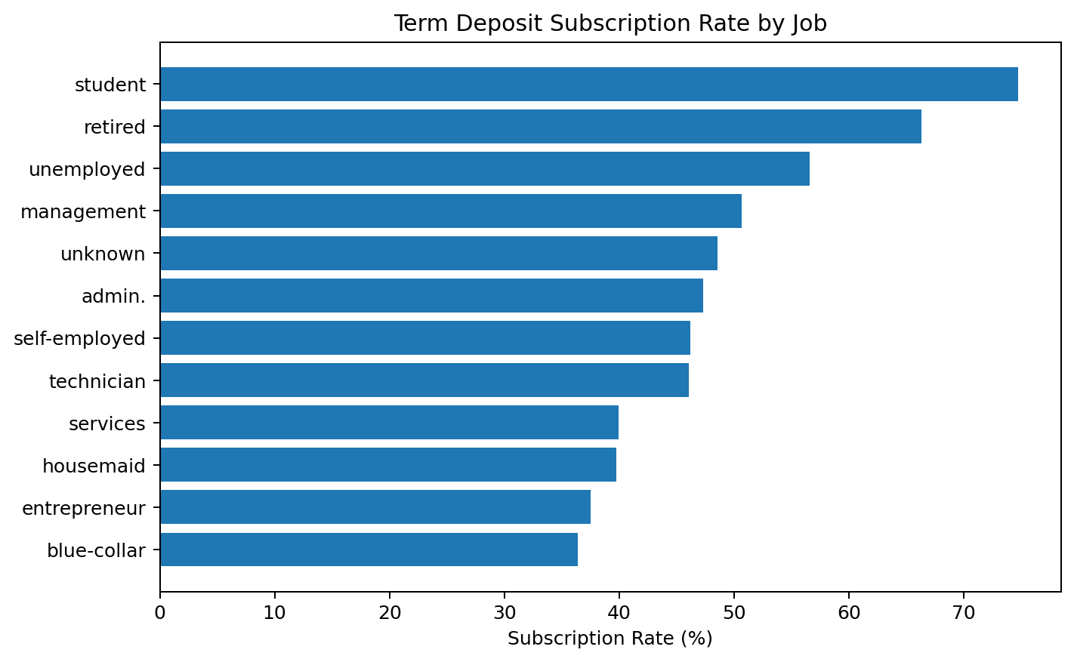
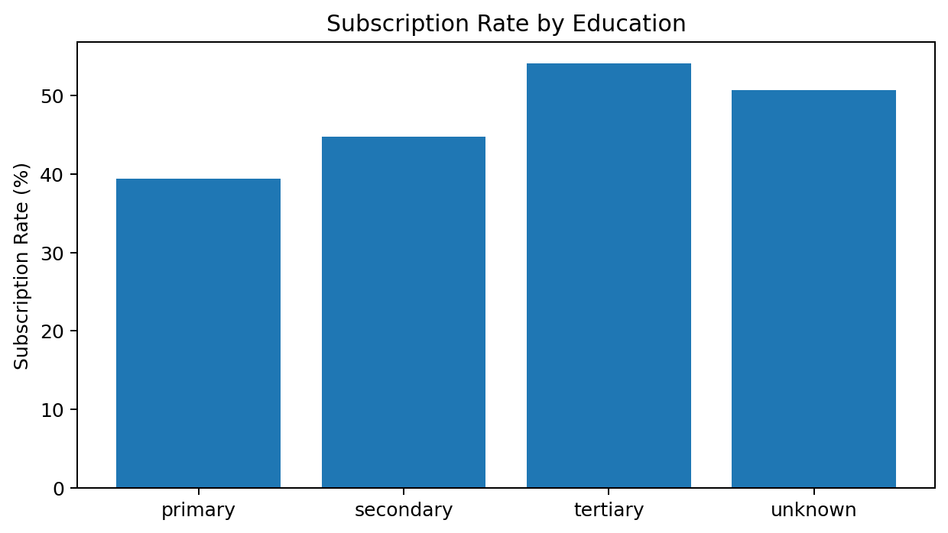
4. Customer Segments
Job, education and marital status
Job: students (74.7%) and retirees (66.3%) show the highest subscription rates.
Education: tertiary-educated customers have a higher rate (54.1%) than primary education (39.4%).

Slide 6
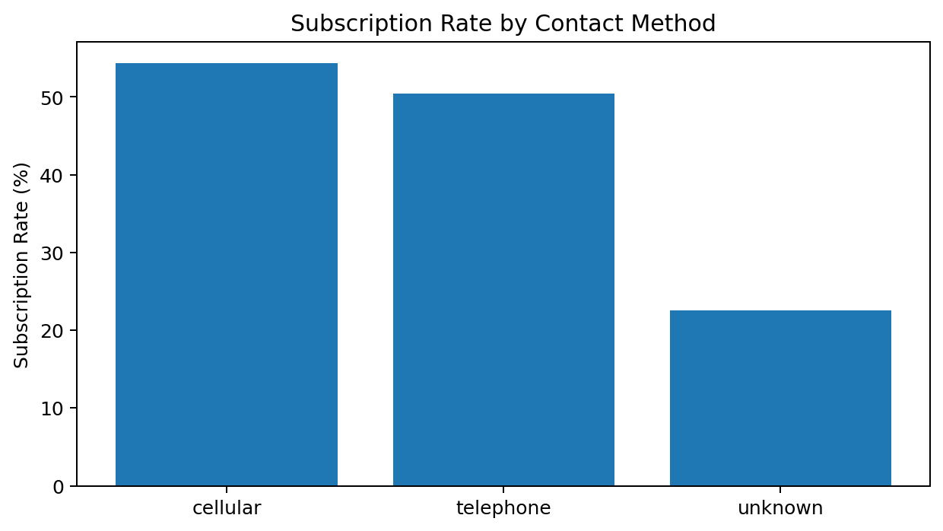
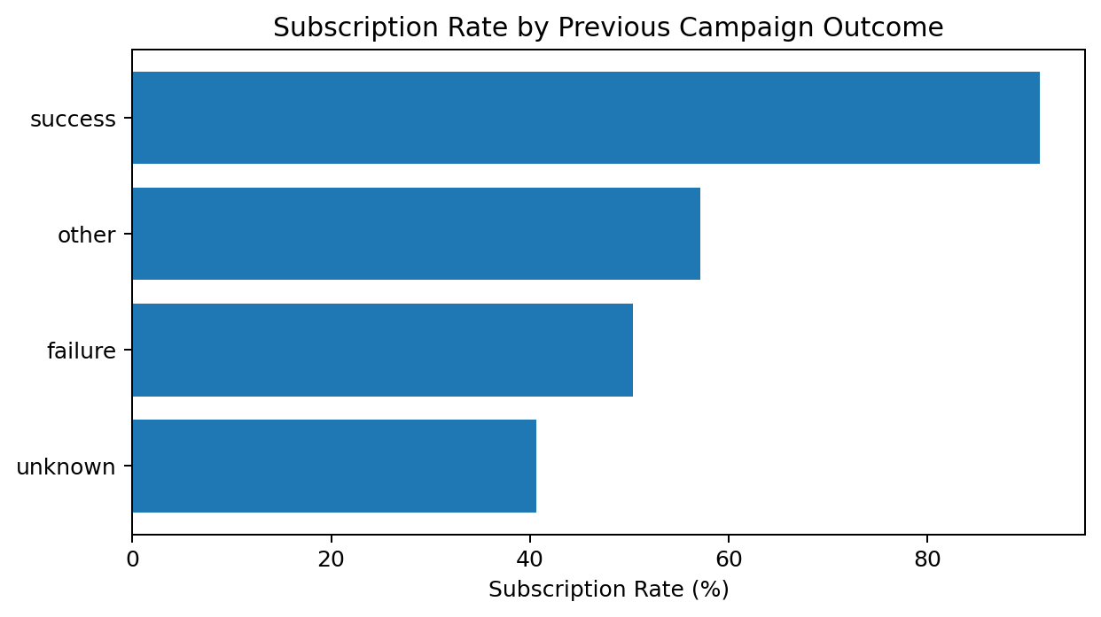
5. Contact Strategy
Contact method and previous campaign outcome
Cellular contacts: 54.3% subscription rate vs 22.6% for customers with an unknown contact method.
Previous success is the strongest descriptive signal: 91.3% subscribed, compared with 40.7% where the previous outcome was unknown.

Slide 7
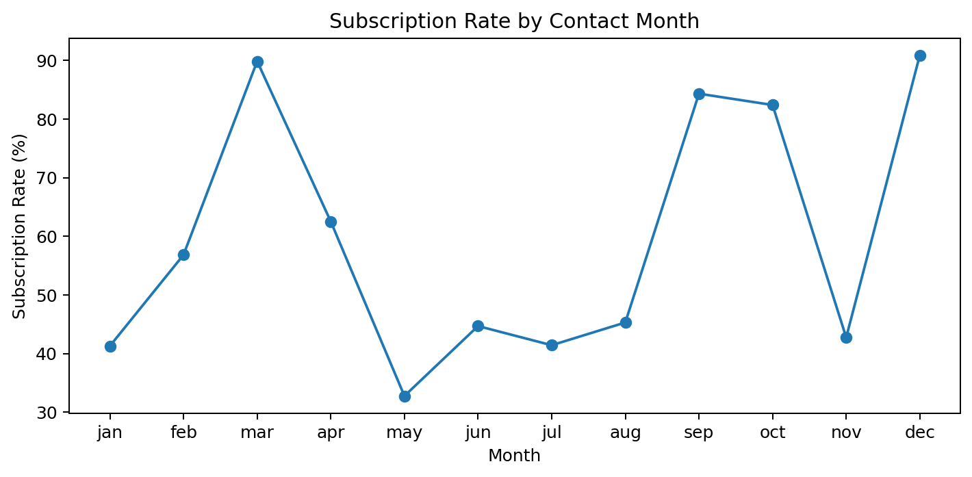
6. Campaign Timing
Subscription rate varies substantially by month
March: 89.9%
December: 90.9%
September: 84.3%
October: 82.4%
July: 41.4%
Insight: Campaign timing may matter. However, monthly differences should be investigated further before changing campaign schedules because the dataset is observational.

Slide 8
7. Major Findings
Overall subscription rate is 47.4%, so the campaign converted nearly half of the customers in this dataset.
Previous campaign success is a major differentiator: 91.3% of customers with a previous successful outcome subscribed.
Students and retirees show the highest job-level subscription rates, suggesting useful segment opportunities.
Tertiary-educated customers have a higher subscription rate than primary-educated customers.
Cellular contacts outperform the unknown contact category, indicating that contact quality/channel availability matters.
Subscription rates vary strongly by month, suggesting a potential timing effect.

Slide 9
8. Business Recommendations
1
Prioritize high-intent customers
Use previous successful campaign outcomes to identify customers with demonstrated interest.
2
Segment marketing campaigns
Tailor messaging for high-performing occupational and education segments.
3
Improve contact-data quality
Encourage accurate, usable contact information and prioritize effective channels.
4
Test campaign timing
Run controlled experiments around high-performing months rather than assuming seasonality is causal.
5
Use analytics continuously
Track subscription rate, segment conversion and campaign efficiency to refine targeting.

Slide 10
Conclusion
The analysis shows that customer response is not evenly distributed across the bank's customer base. Previous campaign outcome, occupation, education, contact method and campaign timing are associated with meaningful differences in subscription rates.
Business takeaway
The bank can improve campaign efficiency by moving from broad outreach toward evidence-based customer segmentation and targeted follow-up.
Python • Pandas • Matplotlib • Seaborn • Exploratory Data Analysis • Business Analytics

